Slide 1

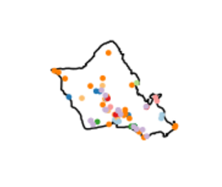
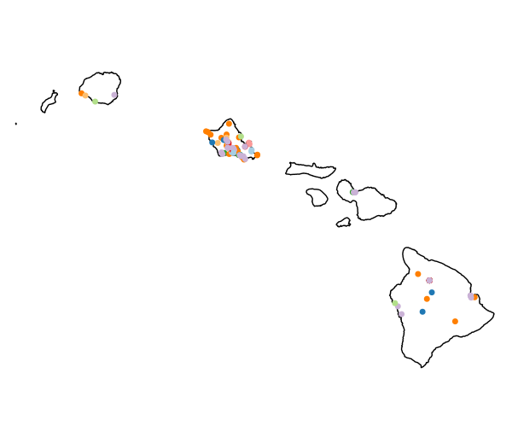
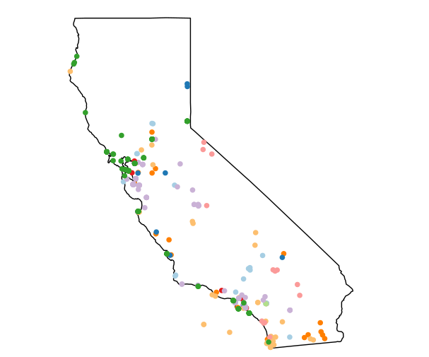
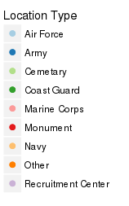
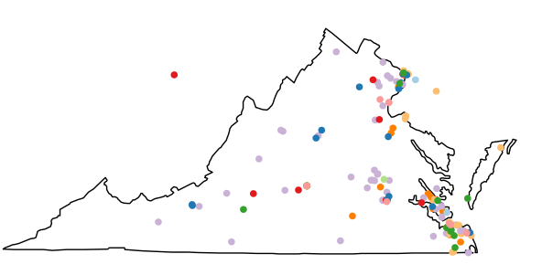
Characterizing Factors that Might Affect
Military Enlistment, Retention, and Attrition
Data Science for the Public Good
Madison Arnsbargar (Virginia Tech), Jessica Flynn (Cornell University), Emily Stark (Austin Peay), with Kathryn Ziemer (SDAL)
Sponsor: Gregory A. Ruark, U.S. Army Research Institute for the Behavioral and Social Sciences
Policy Analysis
Geographic Location
Research Question
Are people influenced to join or leave the Army if new policies are implemented?
  Do certain policy types have a greater impact than others?
Method
Started with the Department of Defense (DoD) Directives and created selection criteria (see below) for deciding if a policy might affect military retention or attrition.
Coded the directives according to the criteria.
Performed a backward search for policy documents starting with widely publicized policies (see Case Study below).
Research Question
Are people influenced to join the Army if they live near military installations, monuments, or national cemeteries?
Method
We created maps displaying military base locations, recruitment centers, memorials and national cemeteries for three states with a high frequency of installations as a preliminary analysis.
Directive Selection Criteria
Military Locations by State
Retirement
Benefits
Veteran status
Training for civilian jobs
Safety
Laws regarding who can use which weapons
Dealing with internal/foreign threats
Sexual harassment
Health
Changes to healthcare
Suicide Prevention Program
Treatment of deceased
Food service programs
Education
GI Bill
Free law school
Privacy
Changes in reporting to higher authorities
Interrogations
Social media/internet use
Grants
Additional monetary compensation
Incentive programs
Awards for service
Promoting diversity
Rules about receiving gifts
Requirements
Foreign language proficiency
Physical fitness
Standards/codes/rules
Dress code
Quality of Life
Receiving packages/mail
Positive work atmosphere/military culture
Non-army activities
Paying for equipment/uniforms out of pocket
DoD Directive
Hawaii
January 23, 2012
Sexual Assault Prevention and Response (SAPR) Program
Creates a culture free of sexual harassment on military grounds.
January 6, 2011
Health Service Support
Sufficient medical personnel to meet mission requirements and training of all medical personnel will be monitored in a comprehensive manner.
California
Transgender
June 8, 2015
Diversity Management and Equal Opportunity in the DoD
Gives DoD personnel the opportunity to rise in ranks with equal opportunity.
Virginia
August 21, 2015
Defense Language, Regional Expertise, and Culture (LREC) Program (DLRECP)
DoD members will be screened for foreign language skills.
Case Study
Next Steps
Women in Combat¹⁻³
Started with the known policy of allowing women to serve in combat positions and performed a search for policy documents.
The Ike Skelton National Defense Authorization Act for Fiscal Year 2011 ordered an investigation into whether or not women have equal opportunities.
Extensive research was done on the issue by the Congressional Research Service, United States General Accounting Office, and the Office of the Under Secretary of Defense.
January 24th, 2013, the USA officially lifted the ban on Women in Combat, which was quickly picked up by the news cycle.
Overall, Congressional Research Service sources as well as news outlets should be considered in policy research.
Research conducted thus far has been descriptive analyses regarding policies and military geographic locations.
Additional data (e.g., DoD, Census, social media) will be combined with the policy and geographic information to explore the effect on retention and attrition.
  Policy:
    We will investigate the patterns of policy implementation on military enrollment and attrition.
    Reactions to policies will be assessed via social media data.
  Geography:
    The location of enrollees will be mapped alongside the geographic location of military installments.
References
1. United States of America, General Accounting Office. (1998). Gender Issues: Information on DoD's Assignment Policy and Direct Ground Combat Definition.
2. U.S.Cong. (2013). Women in combat issues for Congress (D. F. Burrelli, Author) [Cong.]. Washington, D.C.: Congressional Research Service.
3. Women in combat: US military officially lifts ban on female soldiers. (2013, January 25). The Guardian.
bi.vt.edu/sdal

